Slide 1
Drug-Target Interaction Prediction using Enhanced Weighted Profile with Individualized Selection of the Number of Nearest Neighbors

Slide 2
Team Members
Abdullah Al Zoabi
MSc Student @ ELTE University
Li Jianhao
MSc Student @ ELTE University
Supervisor
Dr. Krisztian Buza
Assistant professor, T-Labs @ ELTE University

Slide 3
Introduction
Drug-Target Interaction Prediction (DTI) is an important application of machine learning in pharmaceutical industry, the importance is coming from the fact that we need to save the time and cost of the drugs development [1].
It takes in average 1.8 $ billions and 10 year to bring a new drug to the market [2].
Drug-Target Interaction Prediction (DTI) aims to repositioning the existed drugs, which means use the existed drugs to treat another disease targets [1].

Slide 4
Drug-Target Interaction Prediction (DTI)
Suppose we have the an interaction matrix that represents the known interactions between the drugs and targets.
Each known interaction is represented by “1”, while the unknown interactions are represented by “?”.
DTI aims to predict if the unknown interactions “?” could be an interaction.
 | T1 | T2 | T3
D1 | 1 | ? | 1
D2 | ? | 1 | ?
D3 | ? | 1 | ?
Interaction matrix for 3 drugs and 3 targets.

Slide 5
Input of DTI
Besides the interactions matrix we have also the Drug-Drug and Target-Target similarity matrices which represent the similarity between each pair of drugs and each pair of targets respectively.
 | D1 | D2 | D3
D1 | 1 | 0.647 | 0.539
D2 | 0.647 | 1 | 0.651
D3 | 0.539 | 0.651 | 1
Drug-Drug similarity matrix for 3 drugs.
 | T1 | T2 | T3
T1 | 1 | 0.454 | 0.553
T2 | 0.454 | 1 | 0.601
T3 | 0.553 | 0.601 | 1
Target-Target similarity matrix for 3 targets.

Slide 6
Objective
There many machine learning techniques that have been used for predicting the unknown interactions for example support vector regression, network-based inference … but in this project we are interested in improving the Weighted Profile which is our goal in this project.
Weighted Profile is a kind of Nearest Neighbor classifier, which takes on account the similar drugs and similar targets and their interactions together.

Slide 7

Problem Formulation
$D$ is the set of drugs $D=\{d_{1},d_{2}, ….,d_{n}\}$
$T$ is the set of Targets $T=\{t_{1},t_{2}, ….,t_{m}\}$
$M$ is the interaction matrix where the element $M_{i,j}$ represents the interaction between the drug $d_{i}$ and the target $t_{j}$.
$M_{i,j}=1$ is a known interaction.
$M_{i,j}=0$ is unknown interaction.
$SD$is the Drug-Drug similarity matrix where the element ${SD}_{i,j}$represents the similarity between two drugs $d_{i}$ and $d_{j}$.
$ST$ is the Target-Target similarity matrix where the element ${ST}_{i,j}$ represents the similarity between two targets $t_{i}$and $t_{i}$.

Slide 8

Problem Formulation (Cont.)
$N_{k}\left({ d}_{i}\right)$ is the set of $k$ similar/nearest drugs to ${ d}_{i}$
$N_{k}\left({ t}_{i}\right)$ is the set of $k$ similar/nearest Targets to ${ t}_{i}$
$\hat{M}$ is the predicted interaction matrix where the element ${\hat{M}}_{i,j}$ represents the predicted interaction between the drug $d_{i}$ and the target $t_{j}$.
$K$is the number of nearest neighbors

Slide 9
Weighted Profile
Weighted Profile is a kind of Nearest Neighbor classifier, which depends on the similar drugs and similar targets in prediction.
It consider that the similar drugs are likely to behave similarly in term of interactions with targets [1].
Also it takes the same consideration regarding the targets, i.e., similar targets are likely to behave similarly in term of interactions with drugs.

Slide 10
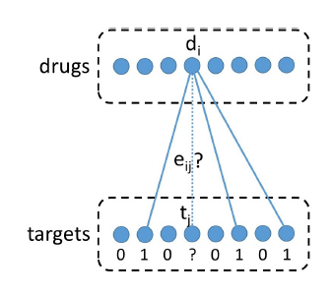
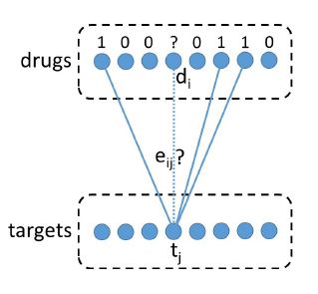
Weighted Profile (Cont.)
Weighted Profile divides the problem of an interaction prediction into two independent predictions and combines the results.
Prediction based on the Drug-Drug similarities [1]
Prediction based on the Target-Target similarities [1]

Slide 11

Weighted Profile (Cont.)
For predicting the interaction ${\hat{m}}_{i,j}$ between the drug ${ d}_{i}$ and target $t_{j}$ first we calculate the weighted average for the interactions of the k Nearest-Drug to $d_{i}$ weighted by the Drug-Drug similarities to ${ d}_{i}$:
${\hat{y}′}_{i,j}$ = $\frac{\sum_{{SD}_{i,x}εN_{k}\left({ d}_{i}\right)}{M_{x,j}{SD}_{i,x}}}{\sum_{{SD}_{i,x}εN_{k}\left({ d}_{i}\right)}{{SD}_{i,x}}}$
Then calculate the average based on the targets :
${\hat{y}′′}_{i,j}$ = $\frac{\sum_{{ST}_{j,z}εN_{k}\left({ t}_{j}\right)}{M_{i,z}{ST}_{j,z}}}{\sum_{{ST}_{j,z}εN_{k}\left({ t}_{j}\right)}{{ST}_{j,z}}}$
The final prediction is the average of ${\hat{y}′}_{i,j}$ and ${\hat{y}′′}_{i,j}$ :
$${\hat{M}}_{i,j}=\frac{{\hat{y}′}_{i,j}+{\hat{y}′′}_{i,j}}{2}$$

Slide 12

Weighted Profile (Cont.)
Function WeightedProfile($M,SD,ST,k$)
$n$ := Number of drugs; $m$ := Number of Targets
$\hat{M}$is a new $n$ by $m$ matrix
for $i :=1$to $n$ do
for $j :=1$to $m$ do
${\hat{M}}_{i,j}$ = PredictSingleEntry ($i,j,M,SD,ST,k$)
return $\hat{M}$
End WeightedProfile

Slide 13

Weighted Profile (Cont.)
Function PredictSingleEntry ($i,j,M,SD,ST,k$)
$N_{k}\left({ d}_{i}\right)$ := the similarities of the $k$ Nearest-Drug to ${ d}_{i}$
$N_{k}\left({ t}_{j}\right)$ := the similarities of the $k$ Nearest-Target to ${ t}_{j}$
${\hat{y}′}_{i,j}$ = $\frac{\sum_{{SD}_{i,x}εN_{k}\left({ d}_{i}\right)}{M_{x,j}{SD}_{i,x}}}{\sum_{{SD}_{i,x}εN_{k}\left({ d}_{i}\right)}{{SD}_{i,x}}}$
${\hat{y}′′}_{i,j}$ = $\frac{\sum_{{ST}_{j,z}εN_{k}\left({ t}_{j}\right)}{M_{i,z}{ST}_{j,z}}}{\sum_{{ST}_{j,z}εN_{k}\left({ t}_{j}\right)}{{ST}_{j,z}}}$
Result $=\frac{{\hat{y}′}_{i,j}+{\hat{y}′′}_{i,j}}{2}$
return Result
End PredictSingleEntry

Slide 14

Weighted Profile (Cont.)
 | T1 | T2 | T3
D1 | 1 | 0 | 1
D2 | 0 | 1 | 0
D3 | 0 | 1 | 0
Example : Calculate ${\hat{M}}_{2,1}$ for $k=2$
${\hat{y}′}_{2,1}$ = $\frac{0.647∗1 + 0.651∗0}{0.647+0.651}=0.498$
${\hat{y}′′}_{2,1}$ = $\frac{0.454∗1 + 0.553∗0 }{0.454 + 0.553}=0.45$
${\hat{M}}_{2,1}= \frac{0.498 +0.45}{2}=0.474$
 | D1 | D2 | D3
D1 | 1 | 0.647 | 0.539
D2 | 0.647 | 1 | 0.651
D3 | 0.539 | 0.651 | 1
 | T1 | T2 | T3
T1 | 1 | 0.454 | 0.553
T2 | 0.454 | 1 | 0.601
T3 | 0.553 | 0.601 | 1

Slide 15
Improving the Weighted Profile
The accuracy of the Weighted Profile depends on the number of nearest neighbors and how good they are.
It happens that a drug is very similar to another drug but it doesn’t interact with same targets which we consider a “Bad” nearest neighbor, these neighbors effect the accuracy of the prediction.
Our goal in this project is reduce the effect of the bad neighbors by using the Hubness-aware Weighting [3].

Slide 16

Hubness-aware Weighting
Suppose as a simple example $d_{1}$ and $d_{2}$ are very similar to each others $d_{1}$ interact with $t_{1}$ while $d_{2}$ doesn’t, however $d_{1}$ will appear as a nears neighbor for $d_{2}$.
Now the interactions are not weighted due to the similarity only but we consider how good or bad these interactions are.
 | T1 | T2 | T3
D1 | 1 | 0 | 1
D2 | 0 | 1 | 0
D3 | 0 | 1 | 0
 | D1 | D2 | D3
D1 | 1 | 0.8 | 0.539
D2 | 0.8 | 1 | 0.651
D3 | 0.539 | 0.651 | 1

Slide 17
Hubness-aware Weighting (Cont.)
Hubness is coming from “hub”, in nearest neighbor classification we call the instance that appears as nearest neighbor for large number of other instances “hub”.
The hub is bad if it appears as nearest neighbor to instance from different class, the good hub is the opposite.
Bad hubs lead to misclassification, so the weighting aims to reduce the effect of these hubs by giving it a low weight.

Slide 18

Hubness-aware Weighting (Cont.)
Definitions :
${BN}_{j}(d_{i})$ is the number of times where the drug $d_{i}$ appears as bad hub in respect to the target $t_{j}.$
${BN}_{j}(t_{i})$ is the number of times where the target $t_{i}$ appears as bad hub in respect to the drug $d_{j}.$
$μ_{{BN}_{j}(d)}$ and $σ_{{BN}_{j}(d)}$ are the mean and standard deviation of the bad occurrence of the drugs in respect to the target $t_{j}.$
$μ_{{BN}_{j}(t)}$ and $σ_{{BN}_{j}(t)}$ are the mean and standard deviation of the bad occurrence of the targets in respect to the drug $d_{j}.$

Slide 19

Hubness-aware Weighting (Cont.)
Definitions :
$WD$ is the matrix of the drugs weights where the element ${WD}_{i,j}$ is the weight of the drug $d_{i}$ in respect to the target $t_{j}$.
$WT$ is the matrix of the targets weights where the element ${WT}_{i,j}$ is the weight of the target $t_{i}$ in respect to the drug $d_{j}$.

Slide 20

Hubness-aware Weighting (Cont.)
Calculating the weights :
${WD}_{i,j}= e^{− \frac{{BN}_{j}\left(d_{i}\right) −μ_{{BN}_{j}(d)}}{σ_{{BN}_{j}(d)}}}$
$${WT}_{i,j}= e^{− \frac{{BN}_{j}\left(t_{i}\right) −μ_{{BN}_{j}(t)}}{σ_{{BN}_{j}(t)}}}$$

Slide 21

Hubness-aware Weighting (Cont.)
Update weighted profile:
${\hat{y}′}_{i,j}$ = $\frac{\sum_{{SD}_{i,x}εN_{k}\left({ d}_{i}\right)}{M_{x,j}{SD}_{i,x} {WD}_{x,j}}}{\sum_{{SD}_{i,x}εN_{k}\left({ d}_{i}\right)}{{SD}_{i,x}}{WD}_{x,j}}$
$${\hat{y}′′}_{i,j}\text{ = }\frac{\sum_{{ST}_{j,z}εN_{k}\left({ t}_{j}\right)}{M_{i,z}{ST}_{j,z}{WT}_{i,z}}}{\sum_{{ST}_{j,z}εN_{k}\left({ t}_{j}\right)}{{ST}_{j,z}}{WT}_{i,z}}$$

Slide 22
Experiment Sitting
Datasets :
Dataset Name | Num. of Targets | Num. of Drugs | Num. of Interactions
Enzyme | 664 | 445 | 2926
Ion Channels | 204 | 210 | 1476
G-protein coupled receptors (GPCR) | 95 | 223 | 635
Nuclear Receptors (NR) | 26 | 54 | 90
Kinase | 442 | 68 | 1527

Slide 23
Experiment Sitting (Cont.)
Evaluation : in our experiments we used leave-one-out cross-validation, i.e., in each round we leave exactly one interaction and try to predict it.
Metrics : we used Area Under Receiver Operator Characteristic Curve (AUC) and Area Under Precision-Recall Curve (AUPR).

Slide 24
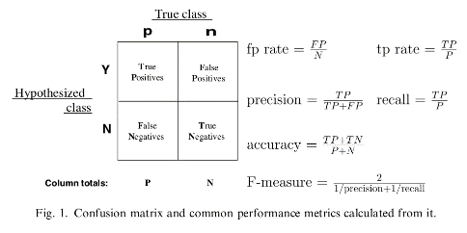
ROC curve and PR curve
Confusion Matrix
Notes:
Image credit for [4]

Slide 25
ROC curve and PR curve (Cont.)
ROC curve: Y, true positive rate. X, false positive rate.
Convex to the upper left will be better.
PR curve: Y, precision. X, recall.
Convex to the upper right will be better.
How to get each point: let each predicted score be the threshold, then we calculate X and Y value.
AUC (area under the curve)
The curve can be ROC or PR.
The value close to 1 will be better.

Slide 26
Simple WP Vs. Improved WP - Kinas

Slide 27
Simple WP Vs. Improved WP - NR

Slide 28
Simple WP Vs. Improved WP - GPCR

Slide 29
Simple WP Vs. Improved WP – Ion Channels

Slide 30
Simple WP Vs. Improved WP – Enzyme

Slide 31

Conclusion
The accuracy of both of simple weighted profile and the improved weighted profile by Hubness-aware weighting is function in the number of nearest neighbors $K$. Where $K$ is a hyper-parameter.
The improving of the weighted profile by Hubness-aware weighting showed a better results in 4 of 5 datasets.

Slide 32
Similarity Based Improvement
The problem of bad hubs occurs when we have two drugs which are very similar but don’t interact with the same target (same for the similar targets).
In this method we recalculate the similarities based on the interaction matrix only, i.e., two drugs are more similar when both interact with more common targets.
Thus, in this method the Drug-Drug and Target-Target similarity matrices are not needed as input.

Slide 33

Jaccard Similarity
To calculate the similarities based on the interaction matrix we use the Jaccard Similarity which is defined as the following :
${SD}_{}^{J}$ is the Drug-Drug Jaccard similarity matrix and the element ${SD}_{i,j}^{J}$represents the similarity between two drugs $d_{i}$ and $d_{j}$.
$${SD}_{i,j}^{J}= \frac{(d_{i}∩ d_{j})}{(d_{i}∪ d_{j})}$$
$(d_{i}∩ d_{j})$ is the number of targets where both drugs interact with.
$(d_{i}∪ d_{j})$ is the number of targets where one or both drugs interact with.

Slide 34

Jaccard Similarity (Cont.)
${ST}_{}^{J}$ is the Target-Target Jaccard similarity matrix and the element ${ST}_{i,j}^{J}$represents the similarity between two targets $t_{i}$ and $t_{j}$.
$${ST}_{i,j}^{J}= \frac{(t_{i}∩ t_{j})}{(t_{i}∪ t_{j})}$$
$(t_{i}∩ t_{j})$ is the number of drugs where both targets interact with.
$(t_{i}∪ t_{j})$ is the number of drugs where one or both targets interact with.

Slide 35

Jaccard Similarity (Cont.)
 | T1 | T2 | T3
D1 | 1 | 0 | 1
D2 | 1 | 1 | 0
D3 | 0 | 1 | 0
Example :
$${SD}_{1,2}^{J}= \frac{1}{3}=0.33$$
$${ST}_{1,3}^{J}= \frac{1}{2}=0.5$$

Slide 36

Improved Weighted Profile
Function ImprovedWeightedProfile($M,k$)
${SD}_{}^{J}$ := DrugDrugJaccardSimilarity($M$)
${ ST}_{}^{J}$ := TargetTargetJaccardSimilarity($M$)
$\hat{M}$ := WeightedProfile($M,{SD}_{}^{J},{ ST}_{}^{J},k$)
return $\hat{M}$
End ImprovedWeightedProfile

Slide 37

Improved Weighted Profile (Cont.)
Function DrugDrugJaccardSimilarity($M$)
$n$ := Number of drugs
${SD}_{}^{J}$is a new $n$ by $n$ matrix
for $i :=1$to $n$ do
for $j :=1$to $n$ do
if $i==j$ then
${SD}_{i,j}^{J} ≔1$
else
${Sim}_{}^{}:= \frac{(d_{i}∩ d_{j})}{(d_{i}∪ d_{j})}$
${SD}_{i,j}^{J}≔Sim$
${SD}_{j,i}^{J } :=Sim$
return ${SD}_{}^{J}$
End DrugDrugJaccardSimilarity

Slide 38

Improved Weighted Profile (Cont.)
Function TargetTargetJaccardSimilarity($M$)
$m$ := Number of targets
${ST}_{}^{J}$is a new $m$ by $m$ matrix
for $i :=1$to $m$ do
for $j :=1$to $m$ do
if $i==j$ then
${ST}_{i,j}^{J} ≔1$
else
${Sim}_{}^{}:= \frac{(t_{i}∩ t_{j})}{(t_{i}∪ t_{j})}$
${ST}_{i,j}^{J}≔Sim$
${ST}_{j,i}^{J } :=Sim$
return ${ST}_{}^{J}$
End TargetTargetJaccardSimilarity

Slide 39
Simple WP Vs. Improved WP - Kinas

Slide 40
Simple WP Vs. Improved WP - NR

Slide 41
Simple WP Vs. Improved WP - GPCR

Slide 42
Simple WP Vs. Improved WP – Ion Channels

Slide 43
Conclusion
Improving the WP by Jaccard similarity showed a significant better results in all datasets, even better than the Hubness-aware.
This results maybe a little bit optimistic, because we make a prediction for an interaction which has been used in the similarity calculation.
Proposed solution : try to make another experiments with excluding these interactions.

Slide 44

Recalculating Jaccard Similarity
$${SD}_{1,2}^{J}= \frac{2}{3}=0.66$$
If the prediction is for $M_{1,1}$ then this interaction is excluded to recalculate the similarity :
$${SD}_{1,2}^{J}= \frac{1}{3}=0.33$$
Exclude an interaction in each round of the leave-one-out cross-validation.
 | T1 | T2 | T3
D1 | 1 | 0 | 1
D2 | 1 | 1 | 1
D3 | 0 | 1 | 0
 | T1 | T2 | T3
D1 | 0 | 0 | 1
D2 | 1 | 1 | 1
D3 | 0 | 1 | 0

Slide 45
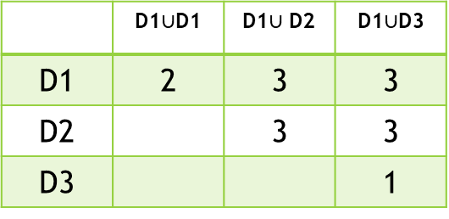
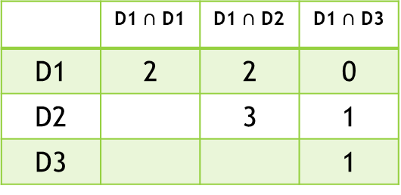
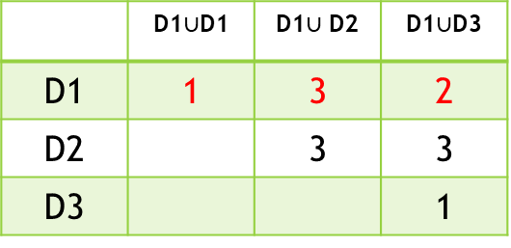
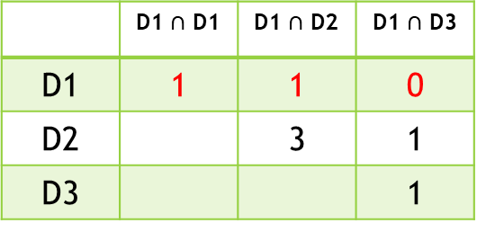
Recalculating Jaccard Similarity (Cont.)
 | T1 | T2 | T3
D1 | 1 | 0 | 1
D2 | 1 | 1 | 1
D3 | 0 | 1 | 0
 | D1 $∩$ D1 | D1 $∩$ D2 | D1 $∩$ D3
D1 | 2 | 2 | 0
D2 |  | 3 | 1
D3 |  |  | 1
 | D1$∪$D1 | D1$∪$ D2 | D1$∪$D3
D1 | 2 | 3 | 3
D2 |  | 3 | 3
D3 |  |  | 1
 | T1 | T2 | T3
D1 | 0 | 0 | 1
D2 | 1 | 1 | 1
D3 | 0 | 1 | 0
 | D1 $∩$ D1 | D1 $∩$ D2 | D1 $∩$ D3
D1 | 1 | 1 | 0
D2 |  | 3 | 1
D3 |  |  | 1
 | D1$∪$D1 | D1$∪$ D2 | D1$∪$D3
D1 | 1 | 3 | 2
D2 |  | 3 | 3
D3 |  |  | 1

Slide 46
Simple WP Vs. Improved WP - Kinas

Slide 47
Simple WP Vs. Improved WP - NR

Slide 48
Simple WP Vs. Improved WP - GPCR

Slide 49
Simple WP Vs. Improved WP – Ion Channels

Slide 50
Conclusion
Recalculating the Jaccard similarity was not the solution, it made results worse then the simple one.
The interaction matrix is very sparse, thus excluding an interaction will lose a significant information.

Slide 51
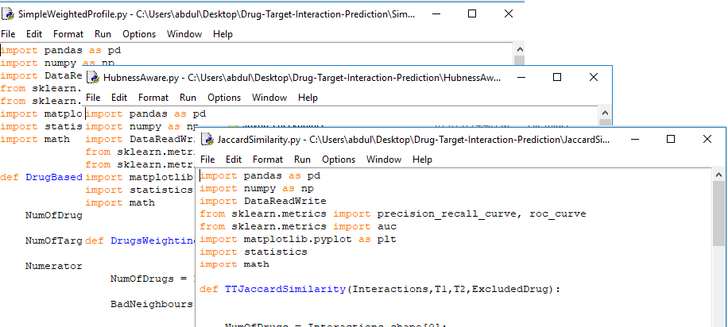
Implementation
Python 3.7.
Speared module for each algorithm.
Git : https://github.com/AbdullahAlZoabi/Drug-Target-Interaction-Prediction

Slide 52
Future Work
Find a middle solution for the Jaccard Similarity based prediction :
Not optimistic.
Don’t lose information.

Slide 53
References
[1] K. Buza, L. Peska : ALADIN: A New Approach for Drug-Target Interaction Prediction, 2017.
[2] Hopkins, A.L.: Drug discovery: predicting promiscuity, 2009. (Copied from [1]).
[3] N. Tomasev, K. Buza, K. Marussy, Piroska B. Kis : Hubness-aware Classification, Instance Selection and Feature Construction: Survey and Extensions to Time-Series, 2015.
[4] T. Fawcett : An introduction to ROC analysis, 2006.

Slide 54
Questions ?

Slide 55
Thank You ☺

Slide 56
Experiment Results (Cont.)
Enzyme
K | Simple WP |  | Hubness – aware |  | Using Jaccard Similarity |  | Jaccard Similarity/ recalculating
1 | 0.92960 | 0.7261 | 0.92960 | 0.7261
2 | 0.9452 | 0.8223 | 0.94996 | 0.87918
3 | 0.9496 | 0.8523 | 0.94996 | 0.87918
4 | 0.95332 | 0.8653 | 0.9499650 | 0.879182
5 | 0.95483 | 0.86888 | 0.949965 | 0.87918
6 | 0.9570 | 0.8697 | 0.949965 | 0.8791827

Slide 57
Experiment Results (Cont.)
G-protein coupled receptors (GPCR)
K | Simple WP |  | Hubness – aware |  | Using Jaccard Similarity |  | Jaccard Similarity/ recalculating
1 | 0.8816 | 0.57462 | 0.8816 | 0.57462 | 0.96702 | 0.903976 | 0.818972 | 0.716525
2 | 0.92277 | 0.62661 | 0.92693 | 0.7149 | 0.97739 | 0.91474 | 0.83875 | 0.6980
3 | 0.9335 | 0.64723 | 0.9383 | 0.76607 | 0.98254 | 0.91287 | 0.8535 | 0.6847
4 | 0.9408 | 0.6433 | 0.9470 | 0.7764 | 0.98468 | 0.91127 | 0.85422 | 0.6729
5 | 0.94355 | 0.6446 | 0.94934 | 0.7717 | 0.98534 | 0.90 | 0.85739 | 0.66368
6 | 0.94370 | 0.64310 | 0.94760 | 0.74539 | 0.98595 | 0.9019 | 0.85588 | 0.647873

Slide 58
Experiment Results (Cont.)
Ion Channels
K | Simple WP |  | Hubness – aware |  | Using Jaccard Similarity |  | Jaccard Similarity/ recalculating
1 | 0.91691 | 0.69194 | 0.91691 | 0.69194 | 0.98446 | 0.96112 | 0.924811 | 0.89135
2 | 0.9532 | 0.7794 | 0.9565 | 0.8344 | 0.98849 | 0.97160 | 0.93651 | 0.902635
3 | 0.9666 | 0.81676 | 0.97033 | 0.87600 | 0.991 | 0.97085 | 0.942106 | 0.897379
4 | 0.9710 | 0.82947 | 0.974 | 0.8797 | 0.9918 | 0.96855 | 0.942634 | 0.8898
5 | 0.9736 | 0.83734 | 0.9762 | 0.8772 | 0.9922 | 0.965387 | 0.94210 | 0.88342
6 | 0.97379 | 0.8356 | 0.9759 | 0.8801 | 0.993 | 0.96281 | 0.94262 | 0.877657

Slide 59
Experiment Results (Cont.)
Nuclear Receptors (NR)
K | Simple WP |  | Hubness – aware |  | Using Jaccard Similarity |  | Jaccard Similarity/ recalculating
1 | 0.8427 | 0.4850 | 0.84277 | 0.4850 | 0.96349 | 0.86997 | 0.67763 | 0.4897
2 | 0.8870 | 0.5539 | 0.9017 | 0.71136 | 0.97976 | 0.93 | 0.70254 | 0.46132
3 | 0.8873 | 0.5853 | 0.899 | 0.75633 | 0.97956 | 0.93532 | 0.69330 | 0.4299
4 | 0.89133 | 0.59299 | 0.90386 | 0.72924 | 0.97917 | 0.934828 | 0.6811 | 0.40267
5 | 0.8867 | 0.604 | 0.9013 | 0.72679 | 0.97736 | 0.8911 | 0.6823 | 0.4095
6 | 0.88843 | 0.5876 | 0.90591 | 0.70949 | 0.97725 | 0.8886 | 0.68169 | 0.410531

Slide 60
Experiment Results
Kinas
K | Simple WP |  | Hubness – aware |  | Using Jaccard Similarity |  | Jaccard Similarity/ recalculating
1 | 0.81189 | 0.52848 | 0.8118 | 0.5284 | 0.95198 | 0.83791 | 0.8186 | 0.6522
2 | 0.875 | 0.57 | 0.8822 | 0.6439 | 0.968 | 0.86186 | 0.853619 | 0.6580
3 | 0.9031 | 0.61388 | 0.9120 | 0.7109 | 0.9784 | 0.87328 | 0.870 | 0.655
4 | 0.91468 | 0.6241 | 0.9249 | 0.7304 | 0.98 | 0.87027 | 0.8808 | 0.6409
5 | 0.9213 | 0.627 | 0.93113 | 0.7289 | 0.9822 | 0.86618 | 0.88861 | 0.63781
6 | 0.9238 | 0.622 | 0.9320 | 0.703 | 0.98364 | 0.865 | 0.892 | 0.635

